Slide 1
Passing References to objects
When an object is passed to a function by use of the default call-by-value parameter passing mechanism, a copy of that object is made.
Although the parameter’s constructor function is not called, its destructor function is called when the function returns.
As you should recall, this can cause serious problems in some instance when destructor frees dynamic memory.
One solution to this problem is to pass an object by reference.

Slide 2
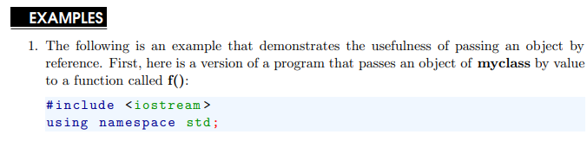
Passing References to objects
When you pass the object by reference, no copy is made, therefore its destructor function is not called when the function returns.
However, that changes made to the object inside the function affect the object used as argument.

Slide 3
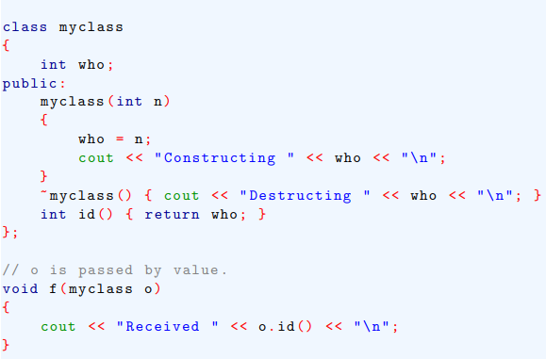
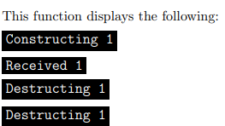
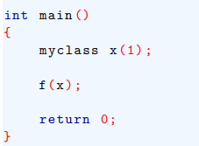
Passing References to objects

Slide 4
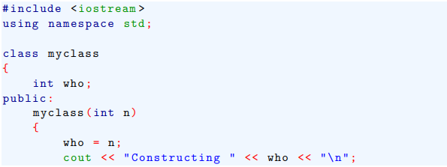

Passing References to objects

Slide 5
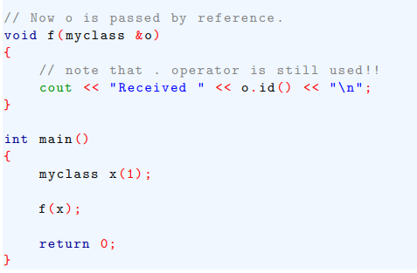
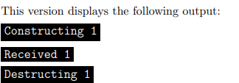
Passing References to objects

Slide 6
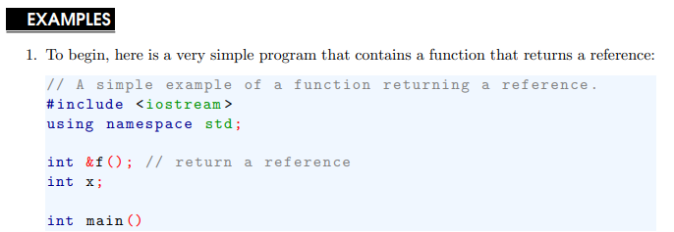
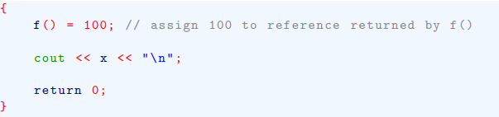
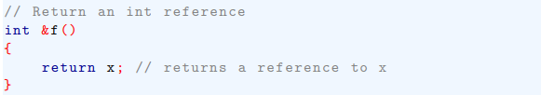
Returning References
Returning a reference can be very useful when you are overloading certain types of operator.

Slide 7
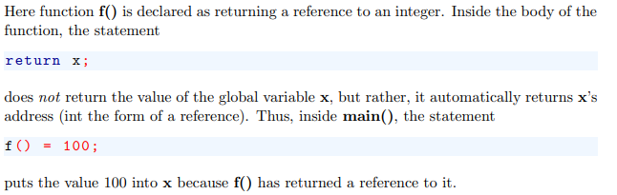

Returning References

Slide 8
Independent References and Restrictions
An independent reference is a reference variable that in all effects is simply another name for another variable.
Because reference cannot be assigned new values, an independent reference must be initialized when it is declared.

Slide 9

Independent References and Restrictions

Slide 10
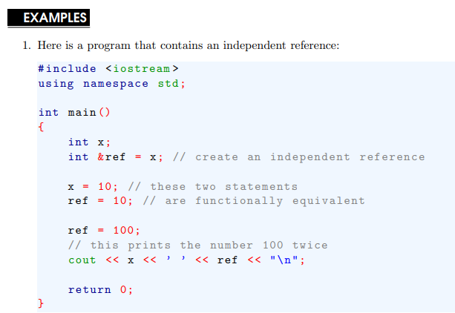
Independent References and Restrictions

